Slide 1

Drug and Alcohol Survey Findings
2023-2024
Notes:
New drugs and alcohol impact
New survey to be alternated every year with Alcohol
From this, hope to build understanding to highlight key behaviours to target and then create communication campaigns and interventions.
This survey was promoted to students in November 2020. Waiting for central national analysis to compare.

Slide 2
Key Details and Demographics
340 respondents in total, 95% increase on 21/22
Age:
  65% were 18–22-year-olds
  23% were 23-29
  15% were 30+
Degree
  96% Undergraduates
  1% Postgraduate
  3% other (Foundation year, PhD)
495 respondents in total, 45% increase on 22/23
Age:
  61% were 18–22-year-olds
  24% were 23-29
  15% were 30+
Degree
  71% Undergraduates
  18% Postgraduate
  11% other (Foundation year, PhD, apprenticeship, A, As level)
Notes:
65% were 18-22 year olds – down 2% on 21/22
23% were 23-29 – same as 21/22
over 30 increase of 5% on last year
96% Undergraduates – up on 74% last year
14% Postgraduate last year, down to 1%
12% other (Foundation year, PhD) last year, down to 3%.
Less of a spread of courses, last year more PG and other.

Slide 3
Significant different in representation from previous years:
43% Defined as female(64%)
46% Defined as male(31%)
11% non-binary, A-gender (2%)
52% heterosexual (70%)
5% Lesbian 1% Gay
29% bisexual (15%)
3% queer (3%)
3% asexual (3%)
29% declared a disability or long-term health condition of these: (9% increase from last year)
58% mental health (11% increase from last year)
45% learning difficulty (49%)
29% report ASD
41% - privately rented house with friends
19% - Halls of Residences
12% - with parents or guardians
9% - rented flat on own
7% - own home with mortgage
4% - rented flat with family
3% - privately-owned halls of residences
65% White British
10% Any other white background
13% BAEM British
9% Asian
3% Arab, Jewish, another ethnic group

Slide 4
Alcohol
21% students are non-drinkers, 7% decrease on last year
31% of students report drinking less than once a week
18% students report drinking 2-3 days per week.
No change from last year's data
Notes:
41% regularly deliberately get drunk before heading out for the night (46% in 2018) – complete shift to less than once a week - 50% of students drink alcohol with the intention of getting drunk less often than once a week, 20% never, 19% about once a week, 12% more than once a week.
Shift from one night out a week to say once a fortnight.
33% of students drink alcohol less than once a week, 18% 2-3 days a week

Slide 5
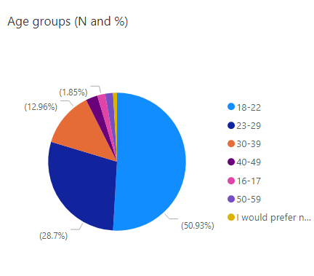
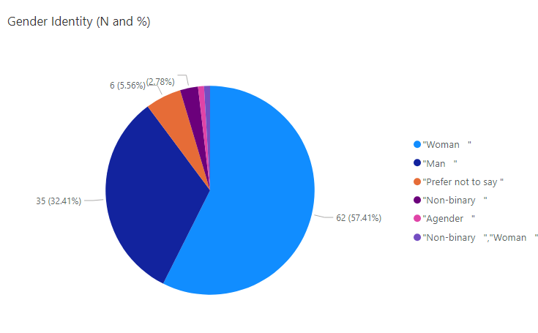
Demographic of non-drinkers

Slide 6
Since 2021-2022 there has been a 10% increase in students choosing not to drink because they don’t like the effects.
Notes:
17% increase in consideration for long term effects of alcohol on health.

Slide 7
0 = very negative impact 10 = very positive impact
Notes:
9% increase in not drinking have a positive impact on life in Uni in general.
1% decrease in it having a fairly negative impact.

Slide 8
3% decrease in very negative impact, still up 8% on pre covid levels.
First year since covid for an increase in positive impact on ability to settle in.

Slide 9
Of those who do not drink alcohol 43% said there were enough social events
28% didn’t know and 28% said no.
Notes:
51% said yes in 2018.
25% said no in 2018.

Slide 10
Since 2021-22
10% increase in students never feeling expected to drink alcohol (up to 49%)
6% decrease in students feeling expected to drink alcohol all the time (3%)

Slide 11
Notes:
This number despite rising from last year is generally reducing overall.

Slide 12
Notes:
87% agree that students do not think about health consequences (83% 2018)
My university friends expect me to drink regularly and get drunk

Slide 13
Drinking behaviours
76% agree that pacing yourself means you’ll have a better night out for longer (2018 - 61%)
73% do not have to get drunk to have a good night out.
76% don't like socialising with people who get very drunk and ruin the night for others
91% students agree non-drinkers can be fun on a night out (2% increase).
33% of students feel pressure from my friends to drink more alcohol than they would like to
Notes:
A slight increase across the board on pressure to drink, remains consistent each year.
68% agree that they tend to stop drinking before they get very drunk, 30% disagree
Page 6 data

Slide 14
9% increase on last year of student who regularly drink at home before going out.
Notes:
In 2022/2023 – a decrease of 17% from 67% (21/22) to 50% regularly drink at a friends house before going out ( this was already on a decrease, considering covid years in between)

Slide 15
Over the past 6 years there has been an 10 % reduction in students regularly deliberately getting drunk before a night out.
Notes:
11% decrease in students deliberately getting drunk before going out on last year, 16% decrease on pre covid levels. More students than even not even considering this behaviour.

Slide 16
***Recommend campaign on drinking in rounds **
Notes:
Very mixed picture re pressure from friends and expectations to drink. Clear that students feel a social norm to drink and sometimes direct pressure or expectations from friends to do this.
Drinking to help relax and socialise has increased by 19% in 21/22 and risen a further 5%.
Drinks offers had decreased by 32% as a motivator in 21/22, rising again, cost of living?
8% increase in pointing to cost of non-alcoholic drinks.
74% drink to fit in with their peers (up from 66%, 12% increase)
Pressure from friends has increased by 13%
76% say student drink to fit in with their peers.
**Recommend campaign on pressure**

Slide 17
Why can it be difficult to control your drinking?
“Takes a while to get drunk”
“Sometimes it just hits you, even when you think you are drinking slowly/responsibly”
“Sometimes you're in a role drinking and don’t necessarily think about how much you have drunk until it hits you.”
“Alcohol can take a while to "hit" me so by the time I realise I'm getting drunk and start drinking water, I sometimes end up black-out half an hour later.”
****Recommend campaign/messaging on how long the effects of alcohol can take to take effect**

Slide 18
Factors to drink more alcohol?
67% students stated it can be difficult not to drink too much because it is easy to get caught up in rounds last year's data suggested 60% students rarely or never buy in rounds, 12% do it most of the time - *Comms piece on drinking in rounds
37% Student’s Deliberately getting drunk at home before a night out
68% agree that they tend to stop drinking before they get very drunk, 30% disagree.

Slide 19
“Nowadays I think more about my behaviour when I drink than I used to”
77% (77%) agree they think about their behaviour when they drink, compared to 73% in 2018.
How can we make more students aware of their behaviour?
80% (77%) agree that students don’t worry enough about how much alcohol will damage their health, 16% (18%) disagree.
Starting to shift to more health conscious in the short term?

Slide 20
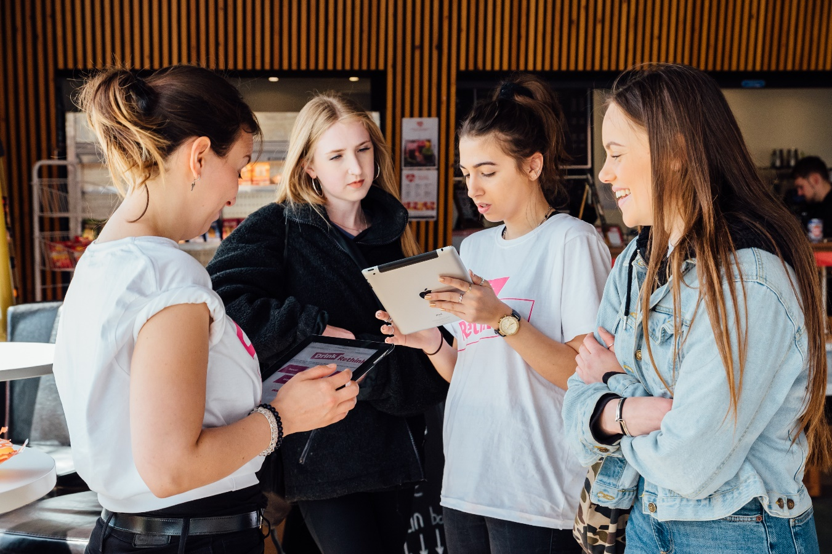
Down 7% on 21/22, 20% of students said that after consuming alcohol it made existing mental health conditions worse or caused a new mental health condition.
63% said alcohol helped them make new friends (down 10% on 21/22), or 40% said it brought them closer to friends and family.
7% lost relationships due to consuming alcohol.

Slide 22
Awareness of responsible drinking campaigns
59% (57%) aware of some responsible alcohol consumption messaging.
Not back to 2021 levels where 70% of students were aware.
Notes:
Mapped comms plan for 2024-2025.
Focusing on alcohol specifically

Slide 23
Drugs

Slide 24
Notes:
4% students agree part of culture, still a large number, but decreased by 22% in the last 2 years.
An additional 10% disagree that it is part of Uni life

Slide 25
Drug Use: perceptions and perceived reality
Notes:
The perception of student's takings drugs increases once they have arrived.

Slide 27
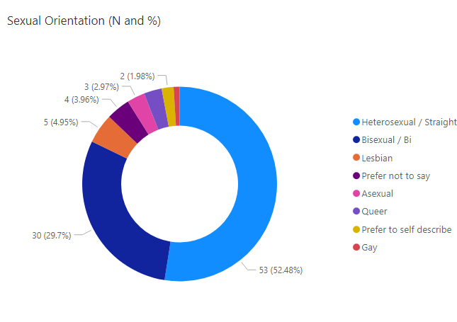
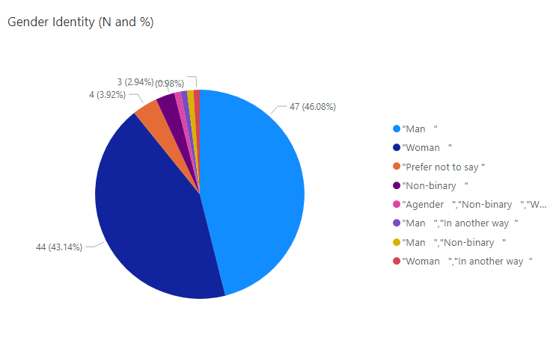
Demographic of students who currently use drugs
95% UK students
5% International Students
Notes:
Almost half of students who report to currently use drugs do not identify as heterosexual
*LGBTQ+ targets messaging required.

Slide 28
Notes:
For recreation continues to gradually decrease
To enhance social interactions has stayed the same (28%)
Dealing with stress decreased by 12% (17%)
To self medicate stayed the same
Escape reality went up from 20% to 25%
An over all increase in using drugs for reasons other than recreation.

Slide 30
79% (79%) do not feel pressure to take drugs this reduces to 70% of students when looking at current drug using population.
8% (7%) did feel pressure this increases to 14% when looking at current drug using students.
51% agree that student take drugs to fit in with their peers, 16% disagree.
35% (31%) agree that students who take drugs do less well in their studies. 18% (21) disagree.
44% neither agree or disagree or don’t know
30% (22% reduction in last three years) agree there is a problematic culture of drugs at UWE, 27% disagreed (20% increase since last year) 42% student don’t know or unsure.
26% agree that student drug use isn’t as problematic as is widely thought, 40% disagree
Notes:
5%

Slide 31
Reflecting on the last semester, students said:
72% (73%) of students never felt that their friends expect them to do drugs – this is reducing year on year
17% (18%) do feel pressure some of the time
3% (1%) feel pressure most of the time
Where do students take drugs most frequently?
Stay at home/Accommodation: 26% (40%) on a weekly or monthly basis, 21% (24%) never 15%(14% )every day
Local Nightclub: 21% (34%) on a weekly or monthly basis, 36%(38%) never
House Party: 21% (32%) on a weekly or monthly basis, 20% (19%) never
Local Pub/Bar: 21% (24%)on a weekly or monthly basis, 52% (53%) never
            Other: most common was in nature, in the woods: 13% (14%)
            Students’ Union, Union 2: 95% never take drugs there
Notes:
13% reduction in drug use at night clubs on a weekly/monthly basis
14% reduction in drug use at home on a weekly / monthly basis.
44% student report using drugs at a house party occasionally/few times a year
29% student report using drugs at a nightclub occasionally/few times a year

Slide 32
Notes:
These are the top 7 drugs in use, to focus on for harm reduction messages and their combination with alcohol.
Nitros oxide 7% reduction in monthly use 6% increase in never used
2CB was the most noted drug which was not asked

Slide 33
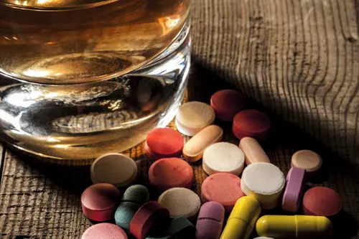
Mixing Drugs
35% of students reported to never use more than one drug at a time *including alcohol.
Most common drug combinations –
Alcohol & Cocaine
Alcohol & Cannabis
Alcohol & Ketamine
Ketamine & Cocaine
MDMA & Cocaine
MDMA & Cannabis
Notes:
2024

Slide 34
Notes:
NO significant changes over the years
Dealing and consequences campaign??

Slide 35
Students get information from their peers (51%), 10% decrease from last year
15% were not aware of the support available through UWE Bristol compared to 11% last year!
59% of students said “I know where to access any advice on or educational information about drugs (informally or formally) but don’t need it” (increase 10%)
11% of students said “I know where to access any advice on or educational information about drugs (informally or formally) and have used it” (decrease 2%)
5% of students said “I don’t know where to access any advice on or educational information about drugs (informally or formally) but would like to” – this is a reduction of 1% on last year (6%).
Notes:
100% of respondents who didn’t use University services, but did use other services, said it was because:
Fear of punishment – 12% (increased by 5%)
Fear of judgement – 12% (increased by 5%)
Fear of implications for academic work – 17% (increased by 6%)
Fear of police involvement – 15% (increased by 7%)
Not aware – 15% (increased by 4%)
24% don’t think it will meet their needs (increased by 15%)

Slide 36
University Drugs Policy
75% (75%) of students are aware that the university has a drugs policy and 42% (40%) of students know at least a little of what the policy says.
Students believe:
The university should not be punishing students who take drugs 55%(44%) agree, 16% (21%) disagree, 29% (15%) either neither agree or disagree or don’t know
Feeling confident in disclosing information about my drug use to my university/college without fear of punishment 36 %(32%) agree, 27% (28%) disagree, (17%) 17% don’t know)
(56%) 50% students feels that if they turned to UWE for support, they would get the right support, 11% (13%) disagree – this increases to 64% when looking at students who currently or previously took drugs
84% (78%) believe that the University should provide support to students who take drugs – this increases to 87% when looking at students who currently or previously took drugs.
Notes:
Slight increase in positive expectations around seeking support – 2024 data

Slide 37
Support at UWE for substance use.
56% of students feel confident that if I turned to my university for support with my drug use that I would
be supported appropriately, 33% unsure.
36% of students feel confident in disclosing information about my drug use to my
university/college without fear of punishment, 37% unsure.
84% of students agree UWE should be providing support to students who take drugs

Slide 38
Consequences experienced during or following taking drugs?

Slide 39
Any other thoughts…
During first year was the only time I have done drugs in my life. After first year I reflected and thought to
myself I needed to stop, and have not touched a drug in more than 2 years now. When I told my friends
my decision, for the most part they were very accepting. However, I believe there is a drug problem on our
UWE campus and university in general that needs to be addressed.
It’s quite uncommon for people to pressure you into taking drugs as they have spent money themselves
on it and so usually want to all rather than making other people use it
promote either harm reduction or promote drug and alcohol support more with posters, emails, on social
media - more often.
I am a foreigner who has been sober since before coming to university and genuinely thought that very
few people in the UK do drugs other than weed, but I was surprised to find out how many of my
colleagues go cocaine and speak so freely of it. Also, I have been offered cocaine 5 times during one
night in the club. I feel like it has been kind of normalized.
I would hope that the university supports students who need it - anyone getting wasted all the time is
clearly not happy. And especially thinking of younger students, away from home, I feel like the university
has a duty of care that enables students to reach out if they need help without risk of being kicked out.

