Slide 1
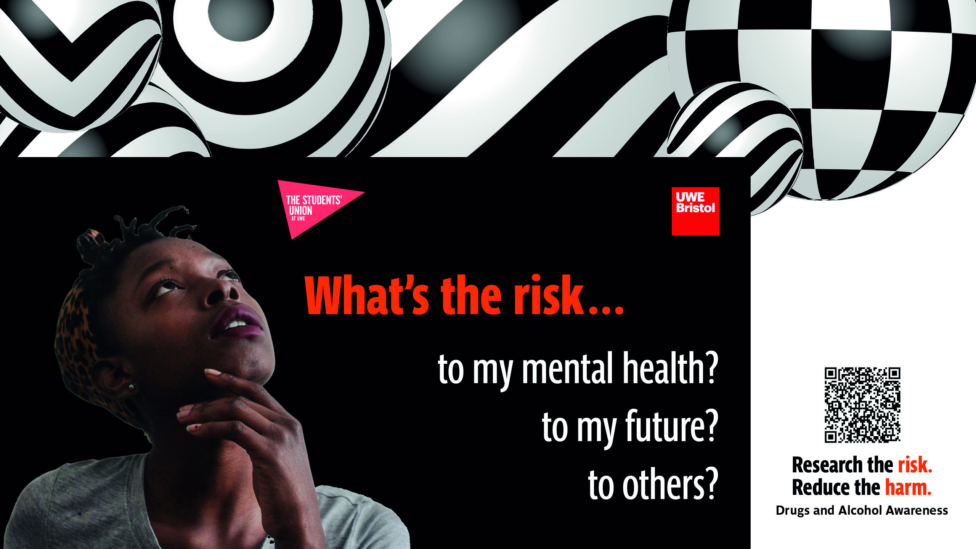
Student Drug & Alcohol Survey 2025
Notes:
This report summarises the findings from a recent survey exploring student attitudes and behaviours relating to alcohol, drug use, and university culture. A total of 509 students responded, with 77% identifying as first-year students. The survey also captured qualitative feedback on initiations, hazing, and alcohol-related traditions.

Slide 2
A total of 509 students responded, with 77% first-year students.
Notes:
This report summarises the findings from a recent survey exploring student attitudes and behaviours relating to alcohol, drug use, and university culture. A total of 509 students responded, with 77% identifying as first-year students. The survey also captured qualitative feedback on initiations, hazing, and alcohol-related traditions.

Slide 3
Branded Slide Deck

Slide 4
Branded Slide Deck

Slide 5
Branded Slide Deck
Notes:
Half of students surveyed have used or currently use drugs

Slide 6
Branded Slide Deck
Notes:
This report summarises the findings from a recent survey exploring student attitudes and behaviours relating to alcohol, drug use, and university culture. A total of 509 students responded, with 77% identifying as first-year students. The survey also captured qualitative feedback on initiations, hazing, and alcohol-related traditions.

Slide 8
Notes:
Womens more likely to use occasionally
Men more likely to use daily/weekly

Slide 9
Branded Slide Deck

Slide 10
Branded Slide Deck
Notes:
31% of heterosexual student have never or no longer drink alcohol compared to 20% of students identify as LGBTQ+
55% of Bisexual student drink at least once a week compared to 44% of heterosexual students
Heterosexual 295
Bisexual 99
Gay or Lesbian 31
Queer 27
I'm not sure how to described myself or I describe myself in a different way 28
I don't want to say 26
e

Slide 11
Branded Slide Deck
Notes:
28% of Gay or Lesbian student using drugs at least every month
29% Bisexual at least every month

Slide 12
Branded Slide Deck
Notes:
Heterosexual students 14% at least using drugs every month
Queers Students 14%

Slide 13
Branded Slide Deck
Notes:
Unsure = 9% at least every month
Didn’t want to disclose or left blank 17%

Slide 14
Alcohol Use
Frequency and Intentions of Drinking
36% of students drink alcohol at least once a week.
56% deliberately get drunk before a night out.
40% drink with the intention of getting drunk.
40% do not agree that “getting drunk means they’ll have a good night out.”
Pre-Drinking Culture
76% of students engage in pre-drinking in their accommodation before going out.
Notes:
Section 1: Alcohol Use
Frequency and Intentions of Drinking
36% of students drink alcohol at least once a week.
56% deliberately get drunk before a night out.
40% drink with the intention of getting drunk.
40% do not agree that “getting drunk means they’ll have a good night out.”
Pre-Drinking Culture
76% of students engage in pre-drinking in their accommodation before going out.
Attitudes Toward Drinking
49% are interested in cutting back on alcohol or going alcohol-free.
46% find it hard not to drink too much on nights out because it’s easy to get caught up in rounds.
80% think drinking and getting drunk is part of university culture.
67% feel their university friends do not expect them to drink or get drunk regularly.

Slide 15
Attitudes Toward Drinking
49% are interested in cutting back on alcohol or going alcohol-free.
46% find it hard not to drink too much on nights out because it’s easy to get caught up in rounds.
80% think drinking and getting drunk is part of university culture.
67% feel their university friends do not expect them to drink or get drunk regularly.
Notes:
This report summarises the findings from a recent survey exploring student attitudes and behaviours relating to alcohol, drug use, and university culture. A total of 509 students responded, with 77% identifying as first-year students. The survey also captured qualitative feedback on initiations, hazing, and alcohol-related traditions.

Slide 16
Beliefs of Drug Use Culture
29% believe taking drugs is part of university culture.
41% disagree that drug use is part of university culture.
49% think students take drugs to fit in with peers.
Notes:
Section 4: Drug Use
Perceptions of Drug Use Culture
29% believe taking drugs is part of university culture.
41% disagree that drug use is part of university culture.
49% think students take drugs to fit in with peers.
Usage Patterns
Half of all students say they have never used drugs.
Among those who do:
38% use cannabis weekly or more.
10% use cocaine weekly or more.
14% use ketamine weekly or more.
29% use mushrooms on special occasions.
20% use poppers sometimes.
57% use more than one substance at a time.
NOS (Nitrous Oxide) Trends
Last year: 63% had never used NOS.
This year: 77% say they have never used it.
Contexts of Use
56% of drug‑using students take drugs in nightclubs.
70% use them at house parties.

Slide 19
Notes:
Students experiencing chronic pain / long term health – either daily or rarely

Slide 20
509 student completed the survey
240 student disclosed they either currently use drugs or have done in the past

Slide 21
Notes:
1/5 of students occasionally using Mushrooms
Students are more likely to have used cocaine or ketamine over MDMA
8% of student who disclosed having used drugs at some point report to have never used cannabis.
Weekly ketamine use and weekly cocaine use on equal

Slide 22
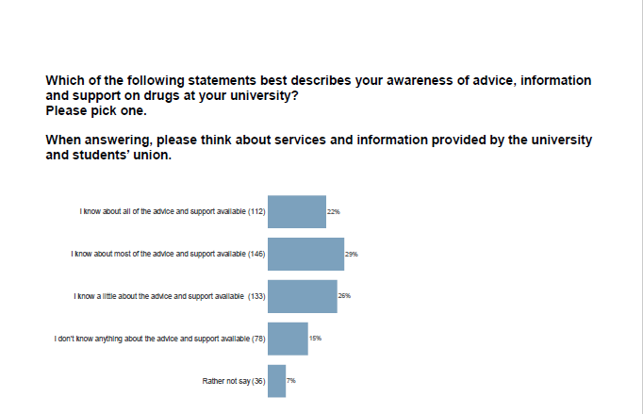
Notes:
77% of students said they are aware of drug information and drug services at the SU and Uni

