Slide 1
Student Reps & Representation
Student Reps are mouthpiece of the student body
Allow your voice be heard
Help influence important decisions at UWE
Engaged, confident and able to speak on behalf of others.
Student Reps can get involved in various projects from accessibility of resources to decolonising the curriculum projects - get involved and make a difference.
Does this sound like something you could do?
Notes:
Students Reps are here to be the mouthpiece of the student body- they are here to allow your voice to be heard. You can help influence important decisions at UWE by giving feedback and becoming a co-creator of the student experience.
By becoming a rep you can make positive change for yourself, your cohort and students to come. You can help your cohort and others.
As a student rep you will get exclusive opportunities such as CDP workshops, access to conferences, guest speakers, plus get your hand on some goodies if you get rep of the month!
Play video from 0.27 https://www.youtube.com/watch?v=PceDDs0iebU

Slide 2
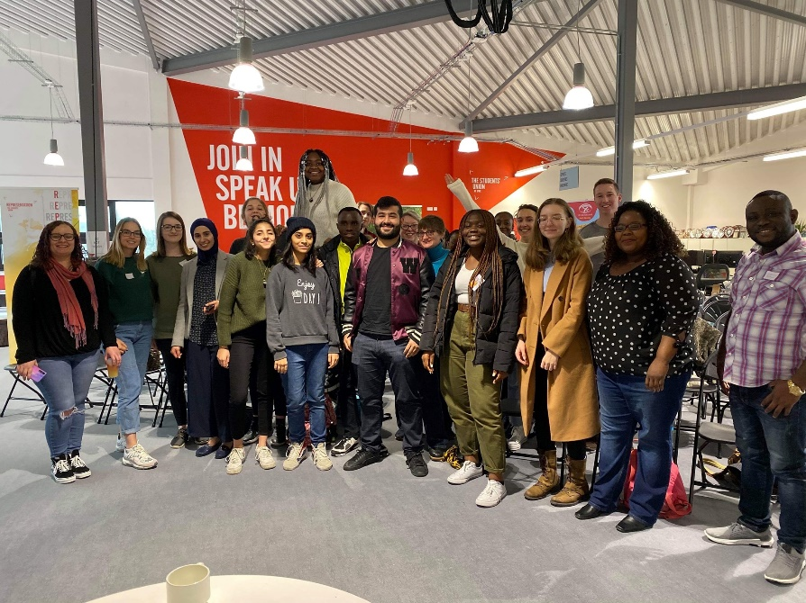
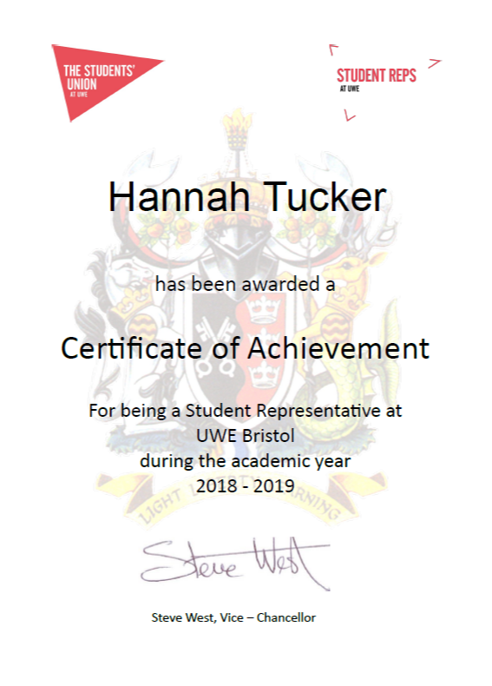
Perks of the role
Awards night!
Exclusive Conferences!
Programme level
Student Reps
Department level
University level
Lead Department Reps
Department Reps
VP Education
Lead Department Reps
Certificates!
Skills development!
Role
Progression!

Slide 3
Does this sound like something you could do?
A member of your programme team will let you know when you have to register your interest to be a Student Rep by.
An election will be held to fairly decide who the Student Rep will be.
So listen out so you don’t miss out on this valuable opportunity!

